Slide 1
IPL PREDECTION ANALYSIS
PRESENTED BY:
ASIS JOVIN A
III YEAR,KVCET,AI&DS
NM ID:au421221243002
Gmail id: asisjovinfernando2003@gmail.com

Slide 2
PROBLEM STATEMENT:
In the realm of sports analytics, particularly in the context of the Indian Premier League (IPL), leveraging collaborative filtering techniques presents a compelling challenge. The IPL, a premier Twenty20 cricket league, features a multitude of players with varying skill sets and performances across different seasons and teams.
The problem at hand involves analyzing player performance data within IPL matches using collaborative filtering methods to derive meaningful insights. Collaborative filtering involves predicting player performance or team dynamics based on past behaviors and interactions, such as batting averages, bowling economy rates, strike rates, and match-winning contributions.
By employing collaborative filtering algorithms, we aim to uncover hidden patterns, player synergies, and team strategies within the IPL ecosystem. This analysis could potentially aid team management in player selection, strategic planning, and identifying key matchups, thereby enhancing their competitive edge in the dynamic landscape of IPL cricket.

Slide 3
PROPOSED SYSTEM
Data collection
Import the necessary functions
Data preparation
Splitting of Data
Data processing
Model building
Training the model
Testing the model
Accuracy of the model

Slide 4
SYSTEM APPROACH
SYSTEM REQUIREMENTS:
HARDWARE: Laptop i3 processor with 4gb ram,keyboard,mouse
Software: Google Collab

Slide 5
Problem Formulation: The problem at hand involves leveraging collaborative filtering techniques to analyze player performance data within the Indian Premier League (IPL). Specifically, the formulation revolves around predicting player performance and team dynamics based on historical data, including batting averages, bowling economy rates, strike rates, and match-winning contributions.
Data Exploration:
Dataset collection.
Exploratory data analysis (EDA).
Algorithm Selection and Implementation:
Utilizing Convolutional Neural Networks (CNNs).
Training and validation.
Model evaluation.
Deployment:
Integration into application.
Scalability and reliability.
Continuous improvement.

Slide 6
.
Features Used for Training:
In the training phase, a variety of features extracted from the IPL data are utilized to build effective collaborative filtering models. These features encompass a wide range of player-specific statistics, match-related metrics, and contextual factors essential for understanding player performance and team dynamics within the IPL.
Player-specific features include batting averages, bowling economy rates, strike rates, number of wickets taken, runs scored, and other performance indicators. These metrics provide insights into individual player capabilities and contributions to their respective teams.
Training Hyperparameters Used:
Epochs:10
Batch size:32
Model Evaluation (Accuracy): 79%

Slide 7
.
Data Preprocessing: Handle missing values, scale features, and encode categorical variables.
Input to Model: A one-line input to the collaborative filtering model could consist of historical player statistics, match outcomes, and contextual factors such as venue conditions, pitch type, and weather conditions, concatenated into a feature vector for training the model.
Model Prediction: Obtain the model's prediction for the new data.

Slide 8
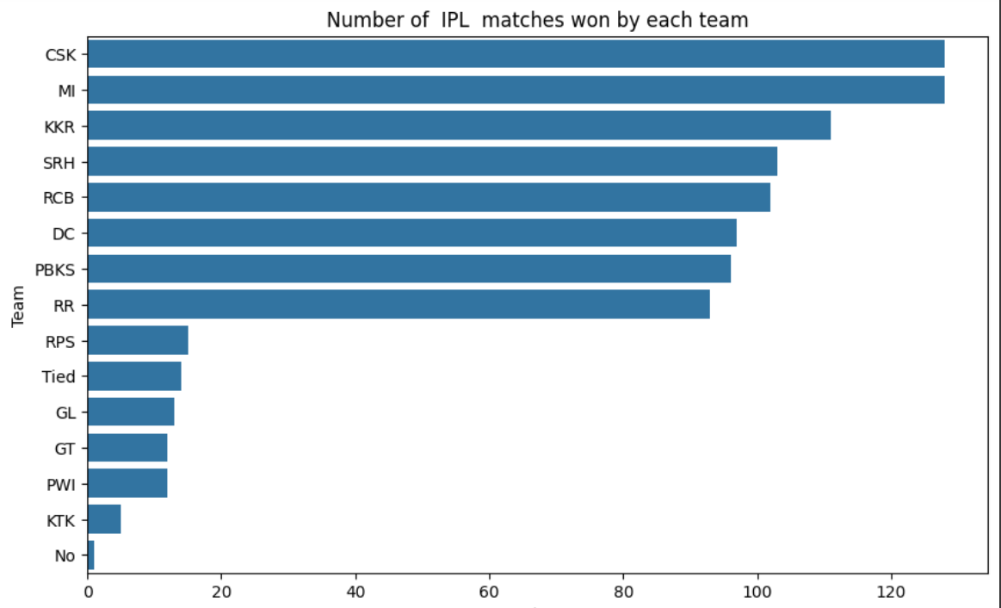
RESULT:
Accuracy :79%
No of team ipl matches won

Slide 9
CONCLUSION:
In conclusion, leveraging collaborative filtering techniques for analyzing player performance data within the Indian Premier League (IPL) offers valuable insights into the dynamics of cricket matches.
By incorporating player statistics, match outcomes, and contextual factors, collaborative filtering models can accurately predict player performance and team synergies, aiding IPL franchises in strategic decision-making and team composition.
Through careful parameter tuning and feature engineering, these models can uncover hidden patterns and relationships within the IPL ecosystem, ultimately enhancing the competitive edge of teams in the league. As the IPL continues to evolve, collaborative filtering remains a powerful tool for extracting actionable insights from vast amounts of historical data, thereby contributing to the growth and success of cricket in the modern era.

Slide 10
Future works:
Moving forward, there are several avenues for future work in the domain of IPL analysis using collaborative filtering techniques. Firstly, incorporating more sophisticated machine learning models, such as deep learning architectures, could further enhance the accuracy and predictive capabilities of the models by capturing complex nonlinear relationships within the data.
Additionally, exploring advanced feature engineering techniques, including sentiment analysis of match commentary and social media data, could provide valuable insights into the psychological and emotional aspects influencing player performance and team dynamics.

Slide 11
REFERENCE:
Data set: https://www.kaggle.com/code/akashdubey022/data-analysis-and-prediction-of-ipl/log
Libraries(pandas,numpy etc….)
Github:https://www.github.com/ipl-analysis

